Slide 1

Sunday 23 July 2023
Quivering with Anticipation

Slide 2
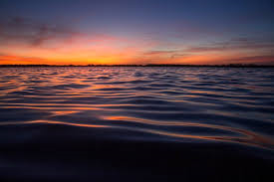
Leader: Where can I go from your spirit?
Or where can I flee from your presence?
All: If I ascend to heaven, you are there;
if I make my bed in Sheol, you are there.
Leader: If I take the wings of the morning and
settle at the farthest limits of the sea
,
All: even there your hand shall lead me,
and your right hand shall hold me fast.

Slide 3
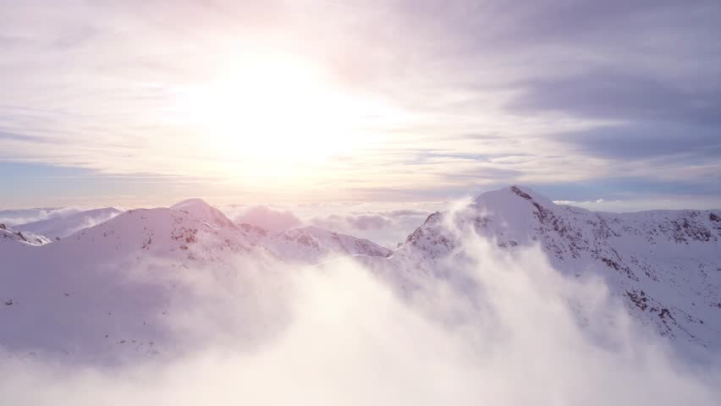
All people that on earth do dwell,
sing to the Lord with cheerful voice:
him serve with mirth, his praise forth tell;
come ye before him and rejoice!

Slide 4
The Lord, ye know, is God indeed;
without our aid he did us make;
we are his folk, he doth us feed;
and for his sheep he doth us take.

Slide 5
O enter then his gates with praise,
approach with joy his courts unto;
praise, laud and bless his name always,
for it is seemly so to do.

Slide 6
For why: the Lord our God is good,
his mercy is for ever sure;
his truth at all times firmly stood,
and shall from age to age endure.
Psalm 100 - Words: William Kethe

Slide 7
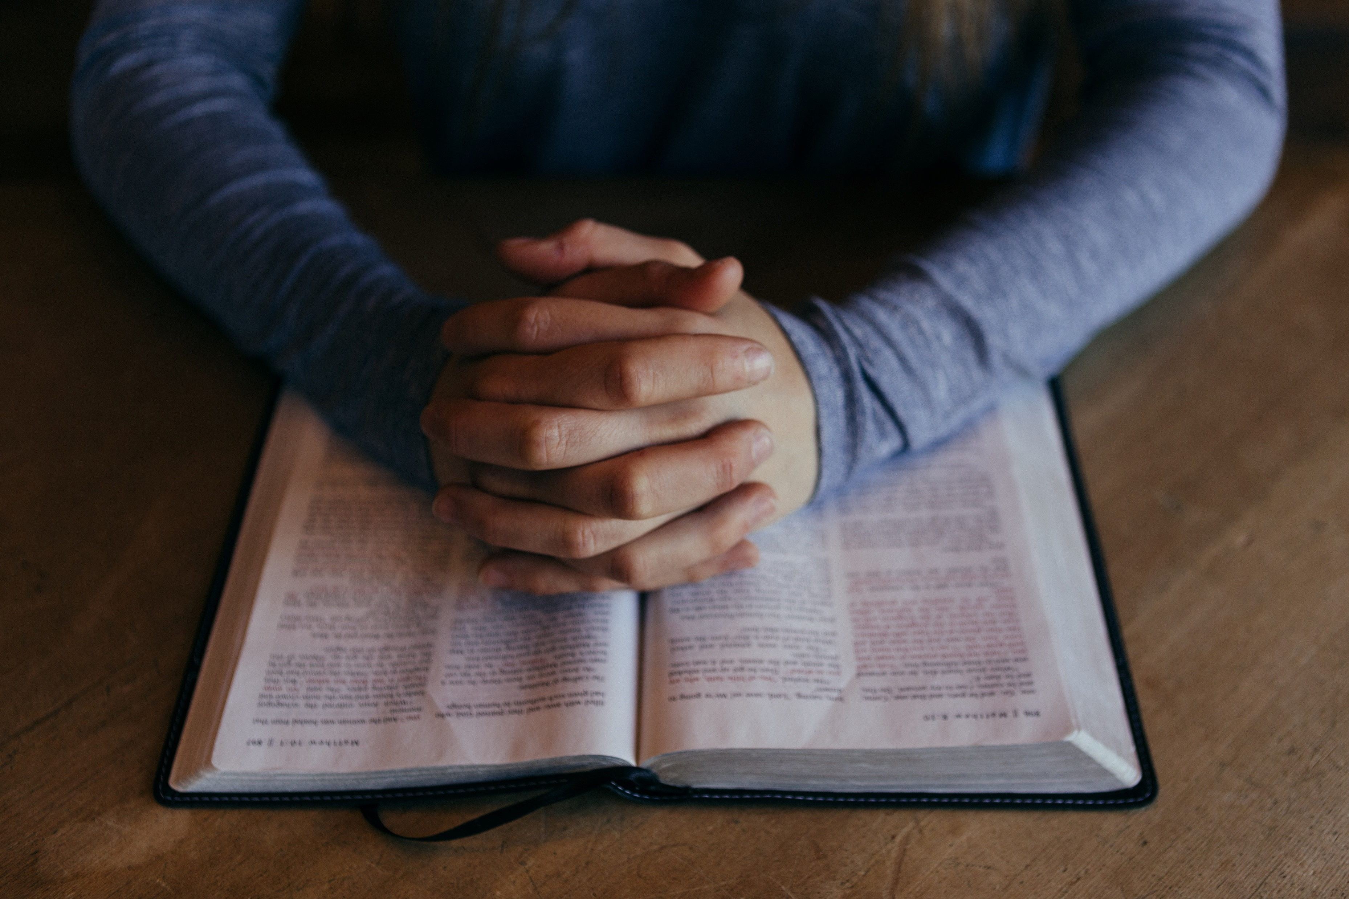
YOUR SPIRIT CALLS US.
The Lord’s Prayer
Our Father, who art in heaven, hallowed be thy name; thy kingdom come; thy will be done; on earth as it is in heaven. Give us this day our daily bread. And forgive us our trespasses, as we forgive those who trespass against us. And lead us not into temptation; but deliver us from evil. For thine is the Kingdom, the power and the glory for ever and ever, Amen

Slide 8
Loving God, You surround us with songs of deliverance, until all our fears are gone.
You have chosen us, and your love has called us by name.
You have adopted us into your family, so that your blood flows through our veins,
Help each of us stand and say, “I’m no longer a slave to fear, I am a child of God.”
YOUR SPIRIT CALLS US.
The Lord’s Prayer
Our Father, who art in heaven, hallowed be thy name; thy kingdom come; thy will be done; on earth as it is in heaven. Give us this day our daily bread. And forgive us our trespasses, as we forgive those who trespass against us. And lead us not into temptation; but deliver us from evil. For thine is the Kingdom, the power and the glory for ever and ever, Amen

Slide 9
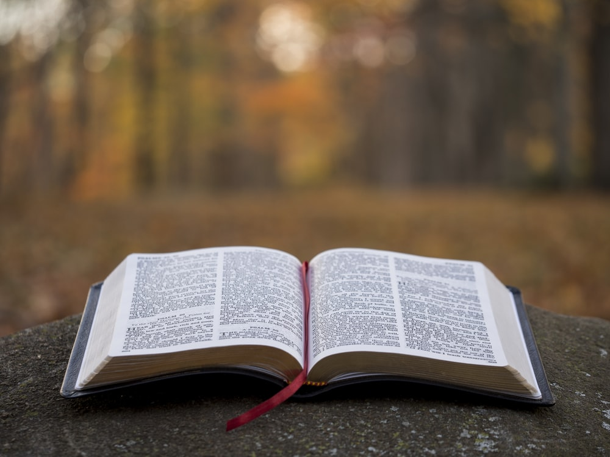
Genesis 28:10-19a

Slide 10
Sunday 23 July 2023
Quivering with Anticipation

Slide 11
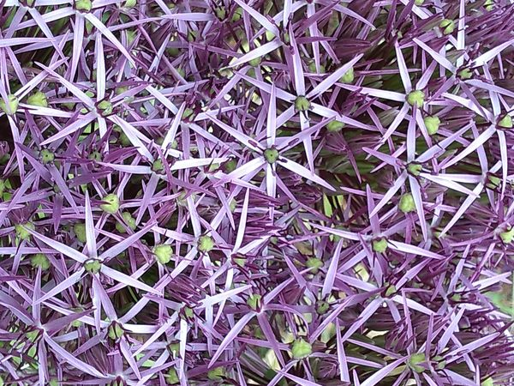
Amazing grace how sweet the sound
That saved a wretch like me
I once was lost, but now I'm found
Was blind but now I see
As grace first taught my heart to fear
So grace my fears relieved
How precious did that grace appear
The hour I first believed

Slide 12
Through many dangers, toils, and snares
I have already come
God’s grace that brought me safe thus far
And He will lead me home
The Lord has promised good to me
His word my hope secures
He will my shield and portion be
As long as life endures

Slide 13
And when the heart and flesh shall fail
And mortal life shall cease
I shall possess within the veil
A life of joy and peace
John Newton

Slide 14
YOUR SPIRIT CALLS US.
The Lord’s Prayer
Our Father, who art in heaven, hallowed be thy name; thy kingdom come; thy will be done; on earth as it is in heaven. Give us this day our daily bread. And forgive us our trespasses, as we forgive those who trespass against us. And lead us not into temptation; but deliver us from evil. For thine is the Kingdom, the power and the glory for ever and ever, Amen
May the grace of the Lord Jesus Christ,
the love of God,
and the fellowship of the Holy Spirit
be with us all.
Evermore
Amen

Slide 15
Romans 8:12-25
Matthew 13:24-30, 36-43

Slide 16
Sunday 23 July 2023
Quivering with Anticipation

Slide 17

1 God is working his purpose out,
as year succeeds to year;
God is working his purpose out,
and the time is drawing near;
nearer and nearer draws the time,
the time that shall surely be:
when the earth shall be filled with the glory of God
as the waters cover the sea.

Slide 18
2 From utmost east to utmost west,
where human feet have trod,
by the mouth of many messengers
goes forth the voice of God:
“Give ear to me, you continents,
you islands, give ear to me,
that the earth may be filled with the
glory of God
as the waters cover the sea.”
.

Slide 19
3 What can we do to work God’s work
To prosper and increase
Love and justice throughout the world
The reign of the Prince of Peace?
What can we do to hasten the time
The time that shall surely be
when the earth shall be filled with the glory of God
as the waters cover the sea.”

Slide 20
4 Let us go forth in the strength of God,
with the banner of Christ unfurled,
that the light of the glorious gospel of truth
may shine throughout the world.
Sin and Sorrow let us fight
to set their captives free,
that the earth may be filled with the
glory of God
as the waters cover the sea

Slide 21
5 All we can do is nothing worth
unless God blesses the deed.
Vainly we hope for the harvest-tide
till God gives life to the seed.
Yet nearer and nearer draws the time,
the time that shall surely be,
when the earth shall be filled with the glory of God
as the waters cover the sea.
Words: Arthur Campbell Ainger

Slide 22
YOUR SPIRIT CALLS US.
The Lord’s Prayer
Our Father, who art in heaven, hallowed be thy name; thy kingdom come; thy will be done; on earth as it is in heaven. Give us this day our daily bread. And forgive us our trespasses, as we forgive those who trespass against us. And lead us not into temptation; but deliver us from evil. For thine is the Kingdom, the power and the glory for ever and ever, Amen

Slide 23
YOUR SPIRIT CALLS US.
The Lord’s Prayer
Our Father, who art in heaven, hallowed be thy name; thy kingdom come; thy will be done; on earth as it is in heaven. Give us this day our daily bread. And forgive us our trespasses, as we forgive those who trespass against us. And lead us not into temptation; but deliver us from evil. For thine is the Kingdom, the power and the glory for ever and ever, Amen
Together we say:
Almighty God, who forgives all that truly repent, have mercy upon us, pardon and deliver us from all our sins, confirm and strengthen us in all goodness, and keep us in life eternal. Through Jesus Christ our Lord.

Slide 24
The Lord’s Prayer
Our Father, who art in heaven, hallowed be thy name; thy kingdom come; thy will be done; on earth as it is in heaven. Give us this day our daily bread. And forgive us our trespasses, as we forgive those who trespass against us. And lead us not into temptation; but deliver us from evil. For thine is the Kingdom, the power and the glory for ever and ever, Amen

Slide 25
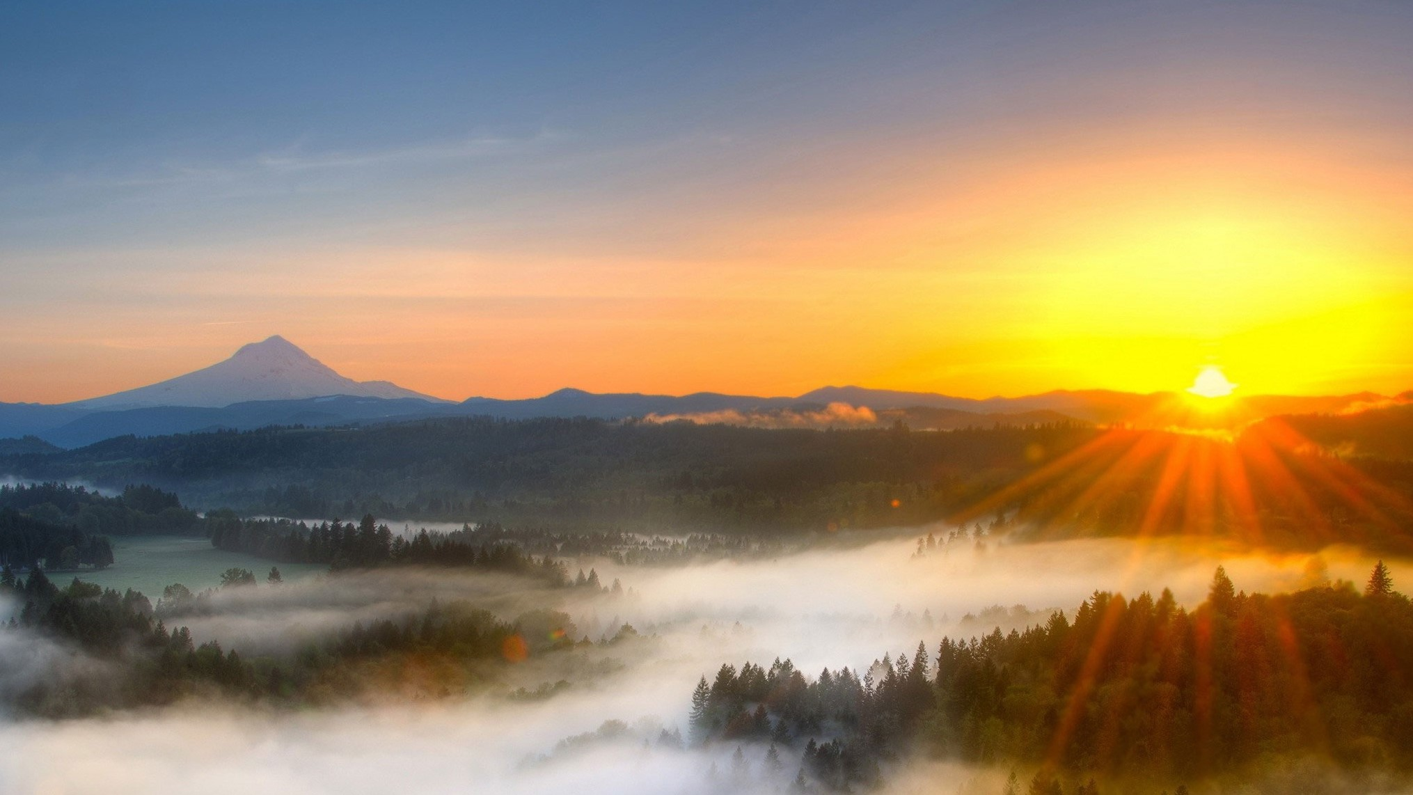
Now thank we all our God,
with hearts and hands and voices,
who wondrous things has done,
in whom his world rejoices;
who from our mother’s arms
has blessed us on our way
with countless gifts of love,
and still is ours today.

Slide 26
O may this bounteous God
through all our life be near us
with ever joyful hearts
and blessed peace to cheer us;
and keep us in his grace,
and guide us when perplexed
and free us from all ills
in this world and the next.

Slide 27
All praise and thanks to God
the Father now be given,
the Son, and him who reigns,
with them in highest heaven,
the one eternal God,
whom heaven and earth adore;
for thus it was, is now,
and shall be evermore.

Slide 28
Sunday 23 July 2023
Quivering with Anticipation

Slide 29
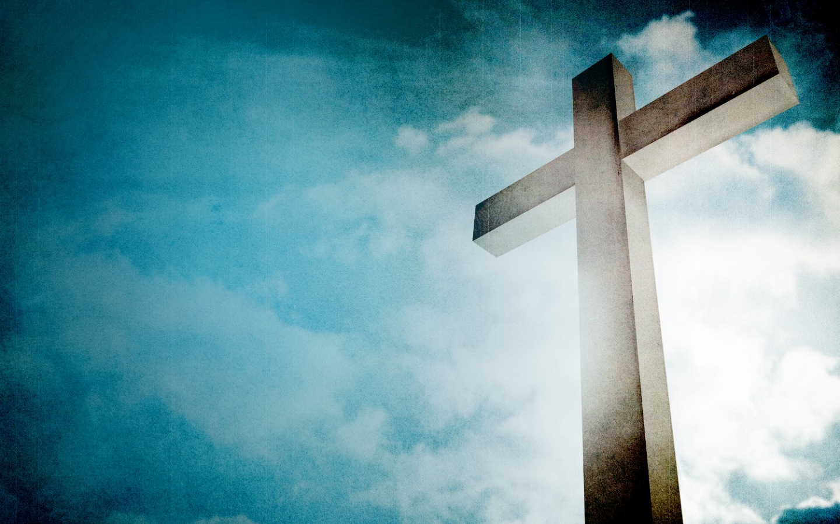
All things come from you, O God,
And of your own have we given you.
Strengthen for service, God, these hands that have worshipped you; may these ears that have heard your word, be deaf to clamour and dispute; may these tongues that have sung your praise be free from deceit; may these eyes which have seen your love continue to shine with the light of hope. Glory be to you forever.

Slide 30
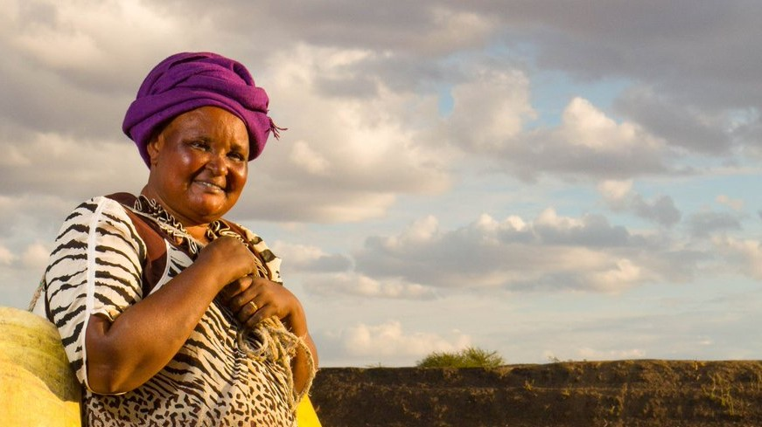
You shall go out with joy
and be let forth with peace,
and the mountains and the hills
will break forth in singing.
There'll be shouts of joy
and the trees of the fields
will clap, will clap their hands;

Slide 31
and the trees of the fields
will clap their hands,
and the trees of the fields
will clap their hands,
and the trees of the fields
will clap their hands,
while you go out with joy.

Slide 32
You shall go out with joy
and be let forth with peace,
and the mountains and the hills
will break forth in singing.
There'll be shouts of joy
and the trees of the fields
will clap, will clap their hands;

Slide 33
and the trees of the fields
will clap their hands,
and the trees of the fields
will clap their hands,
and the trees of the fields
will clap their hands,
while you go out with joy.

Slide 34
Sunday 23 July 2023
Quivering with Anticipation

Slide 35
You are very welcome to join us in the large hall for refreshments after the service
Coming up…
United Prayer Time – Zoom - St Paul’s & South Croydon United Church. Meeting ID: 845 5391 2820 Every Friday, 6pm
Tuesday Guild Summer Coffee Mornings –10.30 -noon. Tuesday 25th July at Fran’s house – 372 Selsdon Road CR2 7AB 07969 173457
Next week – worship is led by John Ellis

